Slide 1

Using Graph Attention Network for Training Rotation Invariant Models to solve the Travelling Salesman Problem
Merve Doganbas, Hongxi Bai, Jonas Littek, 2022-12-06

Slide 2





Outline
Task
Motivation
Method
Results
Conclusion

Slide 3
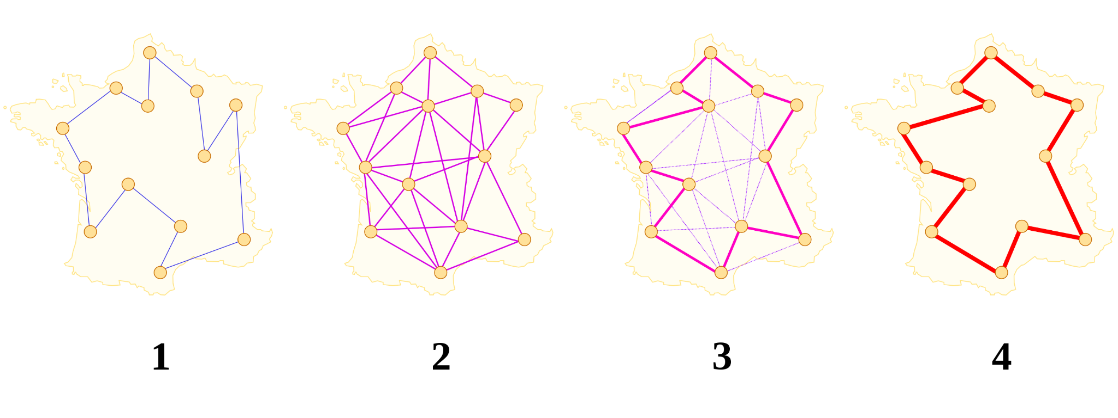
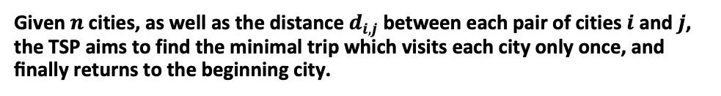
Task
Definition
Given $n$ cities, as well as the distance $d_{i,j}$ between each pair of cities $i$ and $j$, the TSP aims to find the minimal trip which visits each city only once, and ﬁnally returns to the beginning city.
with climate change more extreme weather phenomena
Figure 1: Traveling Salesman Problem (TSP) process

Slide 4
Motivation
Traditional methods are mostly based on operations research methods
high computational costs
with climate change more extreme weather phenomena
with climate change more extreme weather phenomena
Heuristic approaches have been proposed
cannot guarantee optimality of solutions
Usage of expert knowledge
Bound to specific domain
A big problem is the poor generalization

Slide 5
Motivation
TSP instances are naturally highly structured
Good fit for machine learning, no expert knowledge is required
with climate change more extreme weather phenomena
Graph Attention Networks proves the excellent performance of using graph as input
Recently proposed method
We aim to train a rotation invariant graph Attention Network for approximately solving TSP

Slide 6
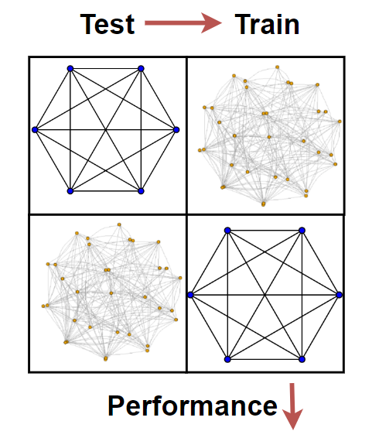
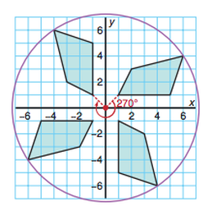
Problems in ML-based Approaches
with climate change more extreme weather phenomena
Rotation Invariance
Generalization

Slide 7
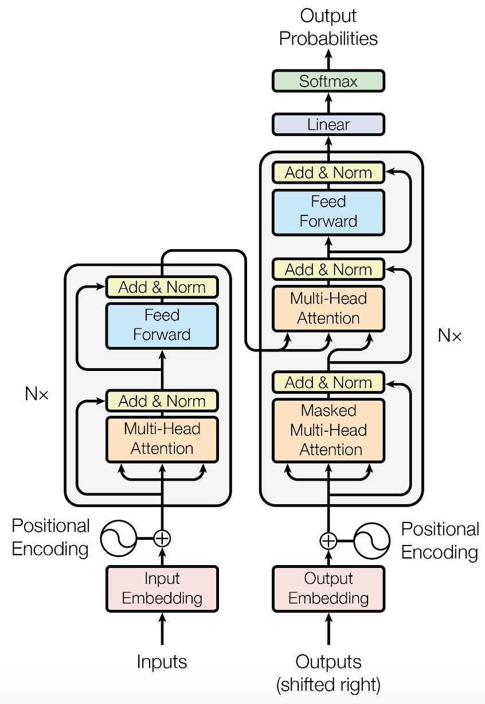
Proposed Method
The left is the encoder part, and the right is the decoder part.
Encoder contains two sublayers. One is the Multi-Head Attention (MHA) layer, and then a Feed Forward(FF) layer.
Decoder has three sublayers. The first two layers are MHA, and the last is the fully connected layer. The first MHA is a stack of self-attention layers, and the second MHA is a stack of encoder-decoder attention layers
with climate change more extreme weather phenomena
Figure 2: The Transformer - model architecture

Slide 8
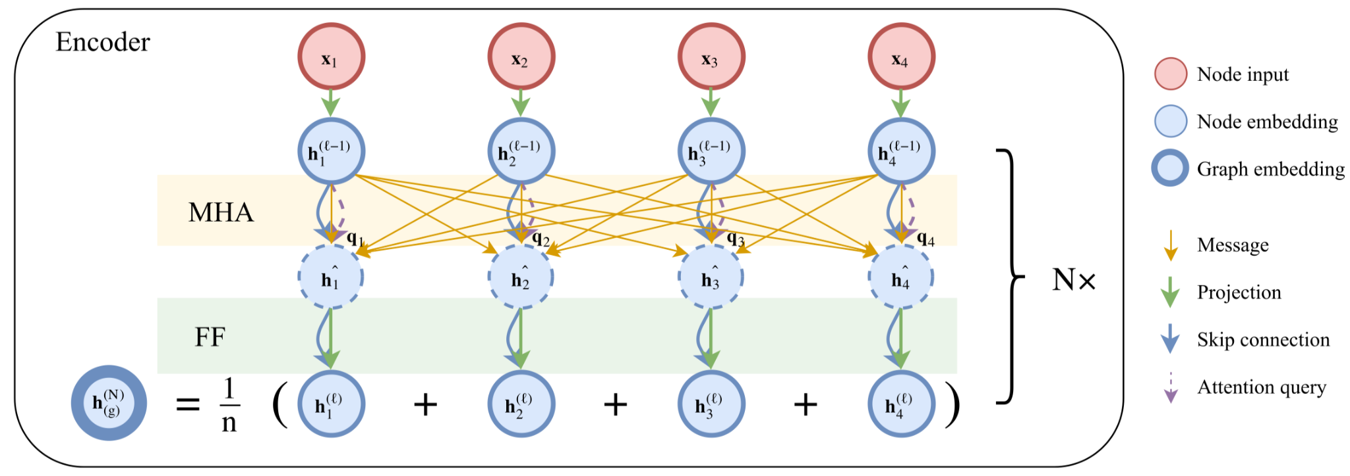
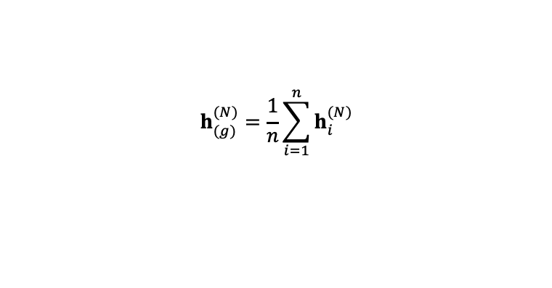
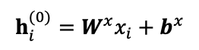
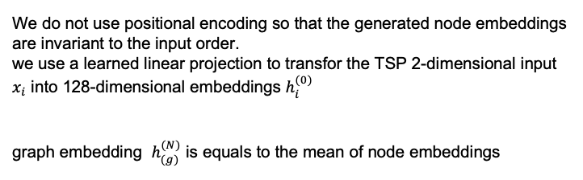
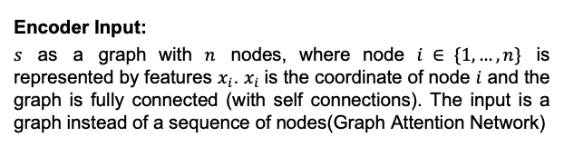
Proposed Method
Figure 3: Attention based encoder
Encoder Input:
$s$ as a graph with $n$ nodes, where node $i ∈ \{1,…,n\}$ is represented by features $x_{i}$. $x_{i}$is the coordinate of node $i$ and the graph is fully connected (with self connections). The input is a graph instead of a sequence of nodes(Graph Attention Network)
We do not use positional encoding so that the generated node embeddings are invariant to the input order.
we use a learned linear projection to transfor the TSP 2-dimensional input $x_{i}$ into 128-dimensional embeddings $h_{i}^{(0)}$
graph embedding $h_{(g)}^{(N)}$ is equals to the mean of node embeddings
$$h_{i}^{(0)}=W^{x}x_{i}+b^{x}$$
$$h_{(g)}^{(N)}=\frac{1}{n}\sum_{i=1}^{n}{h_{i}^{(N)}}$$

Slide 9
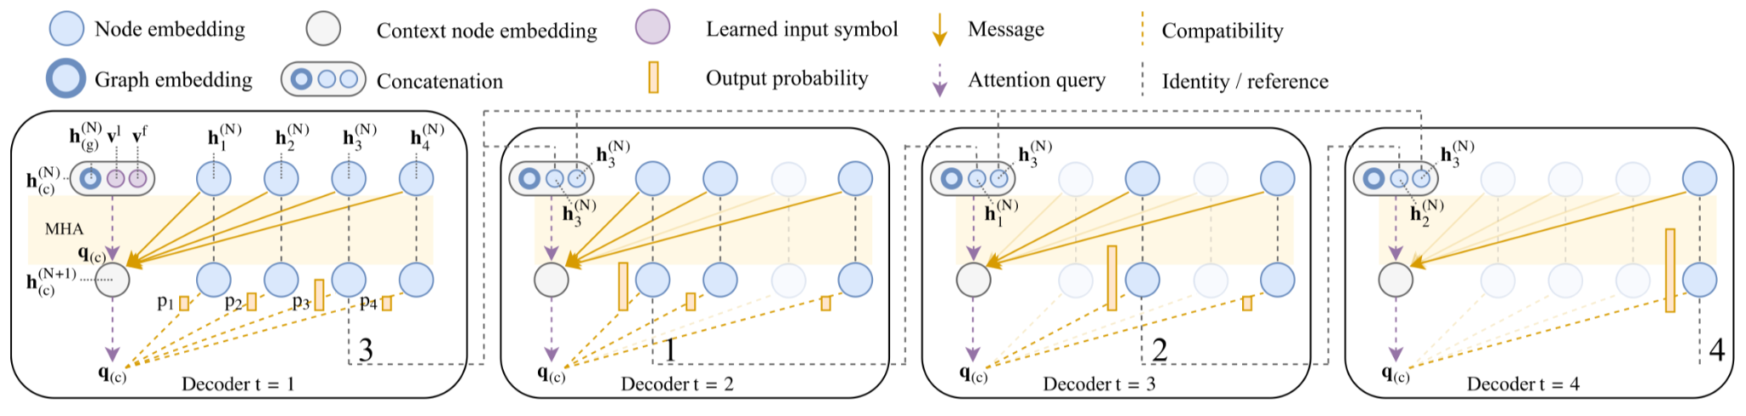
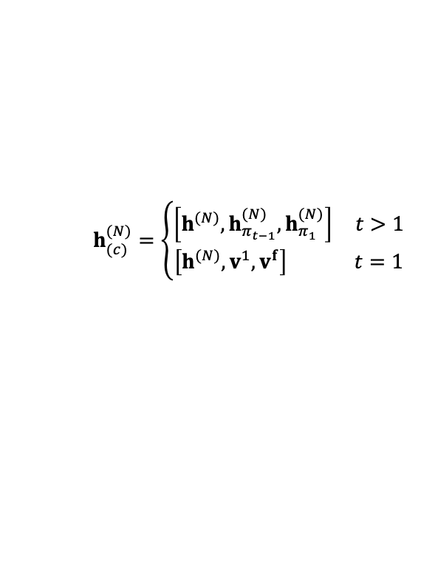
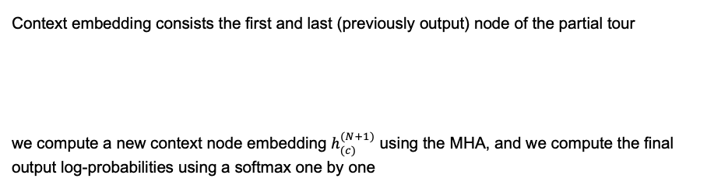
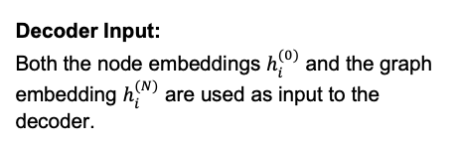
Proposed Method
with climate change more extreme weather phenomena
Figure 4: Attention based decoder, which shows how a tour $π=(3, 1, 2, 4)$is constructed
Context embedding consists the ﬁrst and last (previously output) node of the partial tour
we compute a new context node embedding $h_{(c)}^{(N+1)}$ using the MHA, and we compute the ﬁnal output log-probabilities using a softmax one by one
Decoder Input:
Both the node embeddings $h_{i}^{(0)}$ and the graph embedding $h_{i}^{(N)}$ are used as input to the decoder.
$$h_{(c)}^{(N)}=\left\{\begin{aligned}\left[h^{(N)},h_{π_{t−1}}^{(N)},h_{π_{1}}^{(N)}\right] t>1 \\ \left[h^{(N)},v^{1},v^{f}\right] t=1\end{aligned}\right.$$

Slide 10
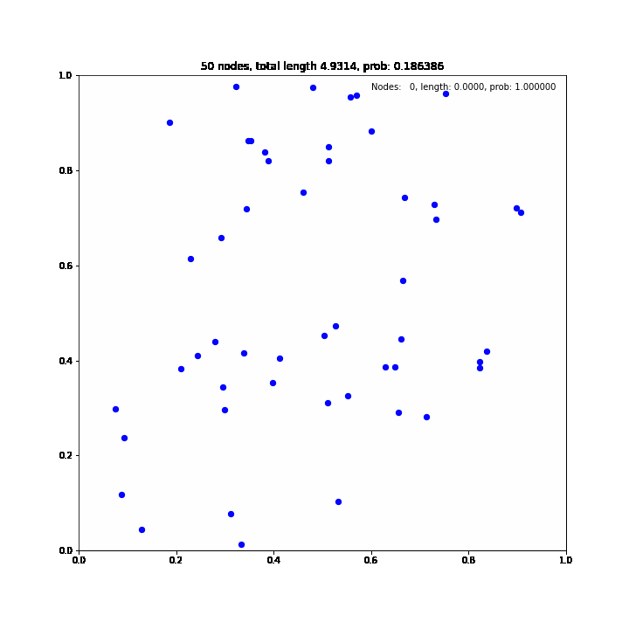
Proposed Method
with climate change more extreme weather phenomena

Slide 11
Results
Experiments
We performed a set of diagnostic experiments to show that the GAT model proposed by Kool et al.(2019) is not invariant to the rotations on the graph instances.
We used the trained parameters for TSP50 and TSP100 provided by the authors. The model performance metric is set to be the optimality gap, and the optimal solutions are obtained by Gurobi.
Dataset
We focus on the 2D Euclidean TSP. Each problem instance, a TSP graph, is composed of n nodes sampled uniformly in the unit square.
We generated 1000 instances for both TSP100 and TSP50.
with climate change more extreme weather phenomena

Slide 12
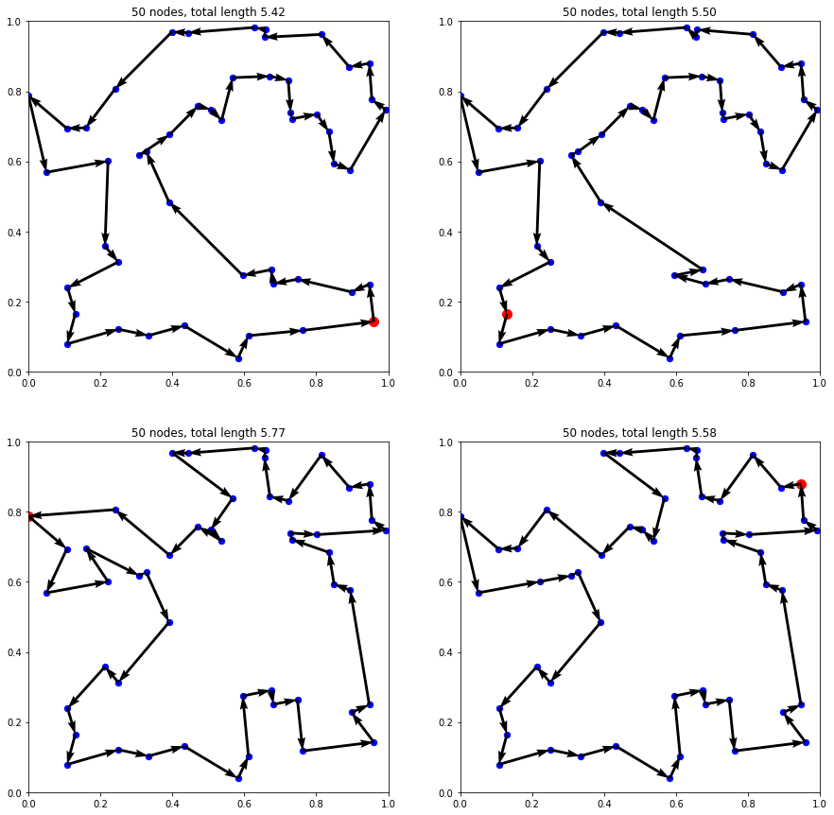
Results
Figure 5: The model produces different routes for the rotations of the same input graph.

Slide 13
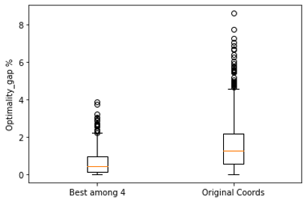
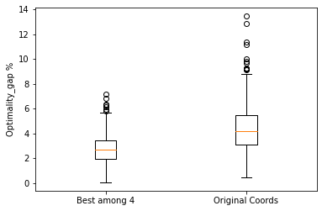
Results
with climate change more extreme weather phenomena
Figure 6: Optimality gap for TSP50
Figure 7: Optimality gap for TSP100

Slide 14
Conclusion
The best among the 4 rotations policy that we mentioned above shows comparable performance to the 128 solutions sampled from the stochastic policy as reported in the original paper. This shows that the GAT is not invariant to the graph rotations.
Thus, by training the same model for rotation invariance is expected to improve the greedy decoding model performance. Thus, we will need a better approach to establish rotation invariance of the model.
Also, we plan to change the node features to improve the model. There are 2 possible approaches. First option is to use the polar coordinates instead of the cartesian coordinates as node features to keep the absolute distance the same when we rotate the graph, but hopefully to provide rotational invariance. The second one is to aggregate multi-angle rotations as the model input which may help us build a more reliable model which can result in better generalization.
with climate change more extreme weather phenomena

Slide 15
Source
https://en.wikipedia.org/wiki/Travelling_salesman_problem#/media/File:Aco_TSP.svg
Vaswani A, Shazeer N, Parmar N, et al. Attention is all you need[J]. Advances in neural information processing systems, 2017, 30.
https://arxiv.org/abs/1706.03762
Bello I, Pham H, Le Q V, et al. Neural combinatorial optimization with reinforcement learning[J]. arXiv preprint arXiv:1611.09940, 2016.
https://arxiv.org/abs/1611.09940
Kool W, Van Hoof H, Welling M. Attention, learn to solve routing problems![J]. arXiv preprint arXiv:1803.08475, 2018.
https://arxiv.org/abs/1803.08475
https://imgs.search.brave.com/05S0F_nqw_ybzyD34TuOAA-kGxEuR9cBo-nODxf6FZM/rs:fit:1200:810:1/g:ce/aHR0cHM6Ly9zdG9y/YWdlLmdvb2dsZWFw/aXMuY29tL3I0bS1i/bG9nLWNkbi8yMDE5/LzEyLzE2NjA2ZmU0/LXRyYXZlbGluZy1z/YWxlc21hbi5qcGc
with climate change more extreme weather phenomena

Slide 16
Thank you
with climate change more extreme weather phenomena

